Slide 1


Final Presentation
Team: 5G

Slide 2

List
table of contents
1
Objective and motivation
2
Project Progress
3
Final Design
4
Evaluations
5
Challenges and Limitations
6
Final Implementation: Demo
ⓒSaebyeol Yu. Saebyeol’s PowerPoint
Notes:
This is table of content for today's presentation

Slide 3


Part 1
Objective and motivation
ⓒSaebyeol Yu. Saebyeol’s PowerPoint

Slide 4
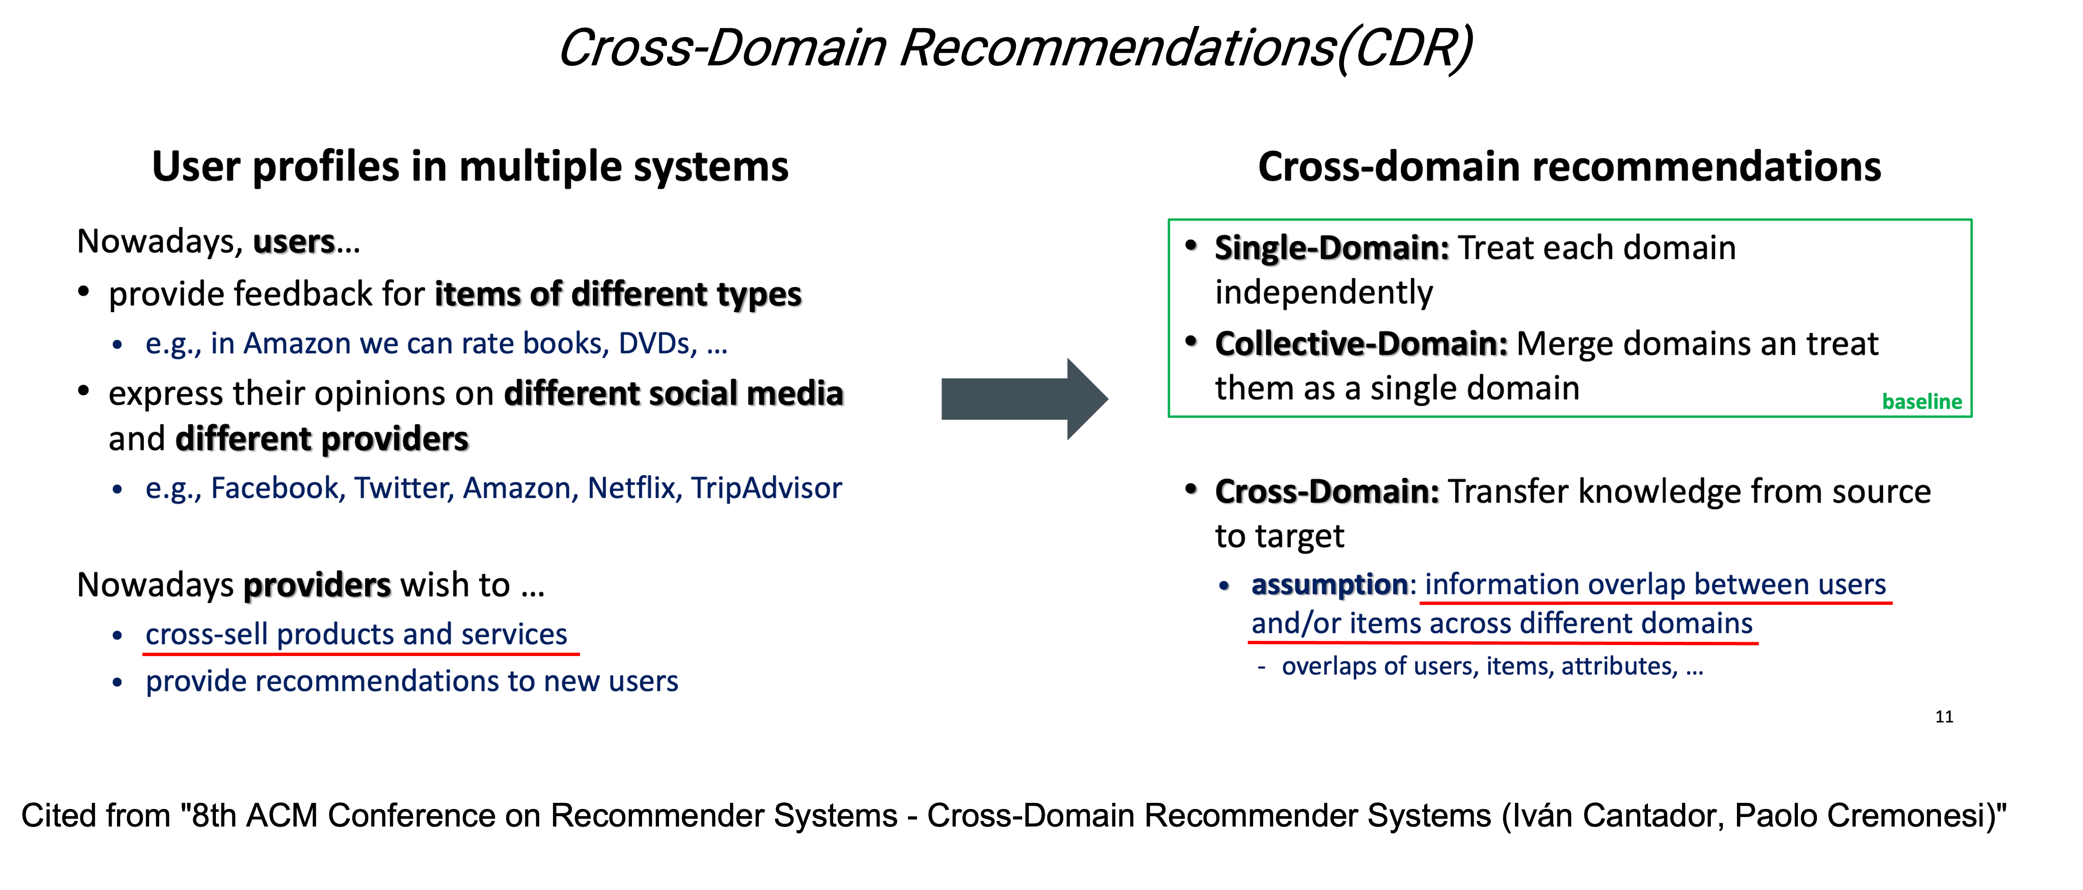
Objective and motivation

Slide 5
Part 2
Project Schedule
ⓒSaebyeol Yu. Saebyeol’s PowerPoint

Slide 6
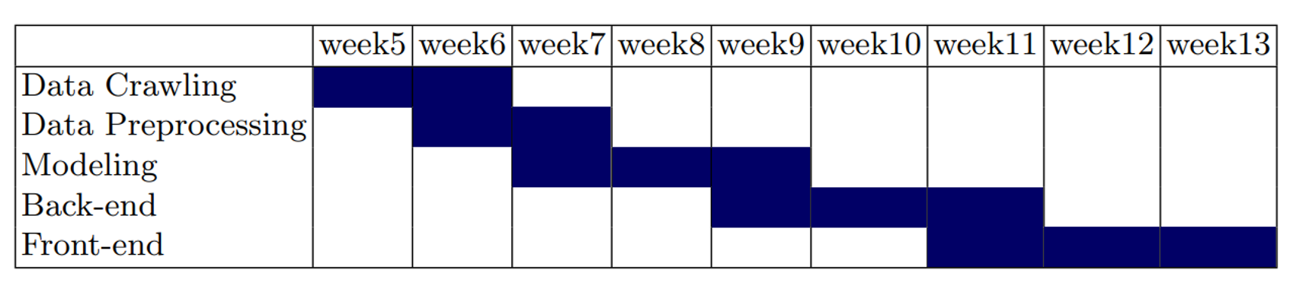
Project progress

Slide 7
Part 3
Final Design
ⓒSaebyeol Yu. Saebyeol’s PowerPoint

Slide 8
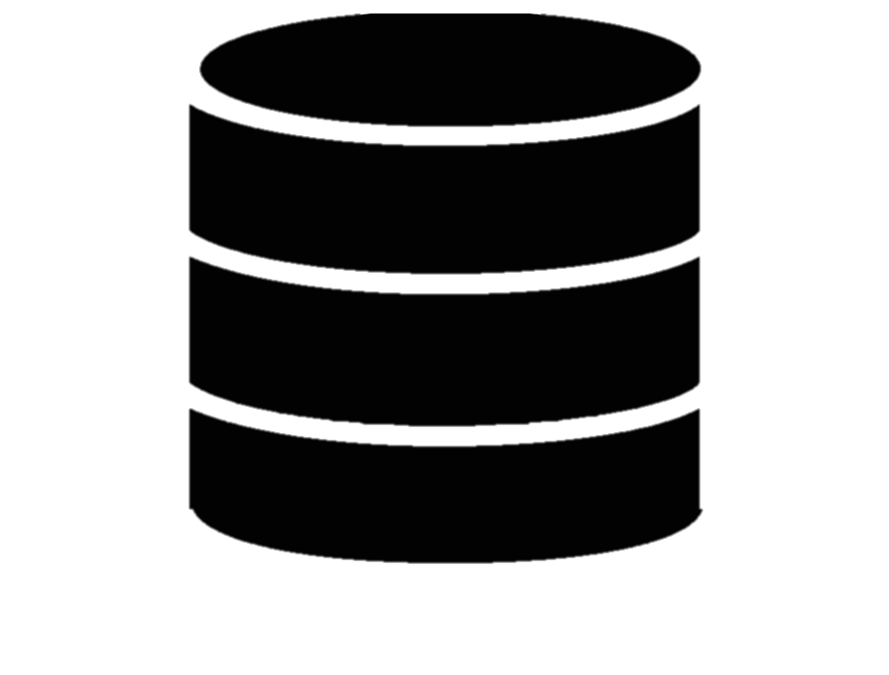







Part 2,
Final Design
drama
webtoon
movie
book
User data
Recommended item
Register & information
User data
Recommended item
User data
Notes:
A schematic diagram of the overall process. First, we recommend contents based through drama, webtoon, and movie datasets. After that, when the user provides information through registration and use, the collaborative filtering model is also used based on this. Finally, we plan to provide the items recommended by the two models in proportion to the information provided by the user.

Slide 9
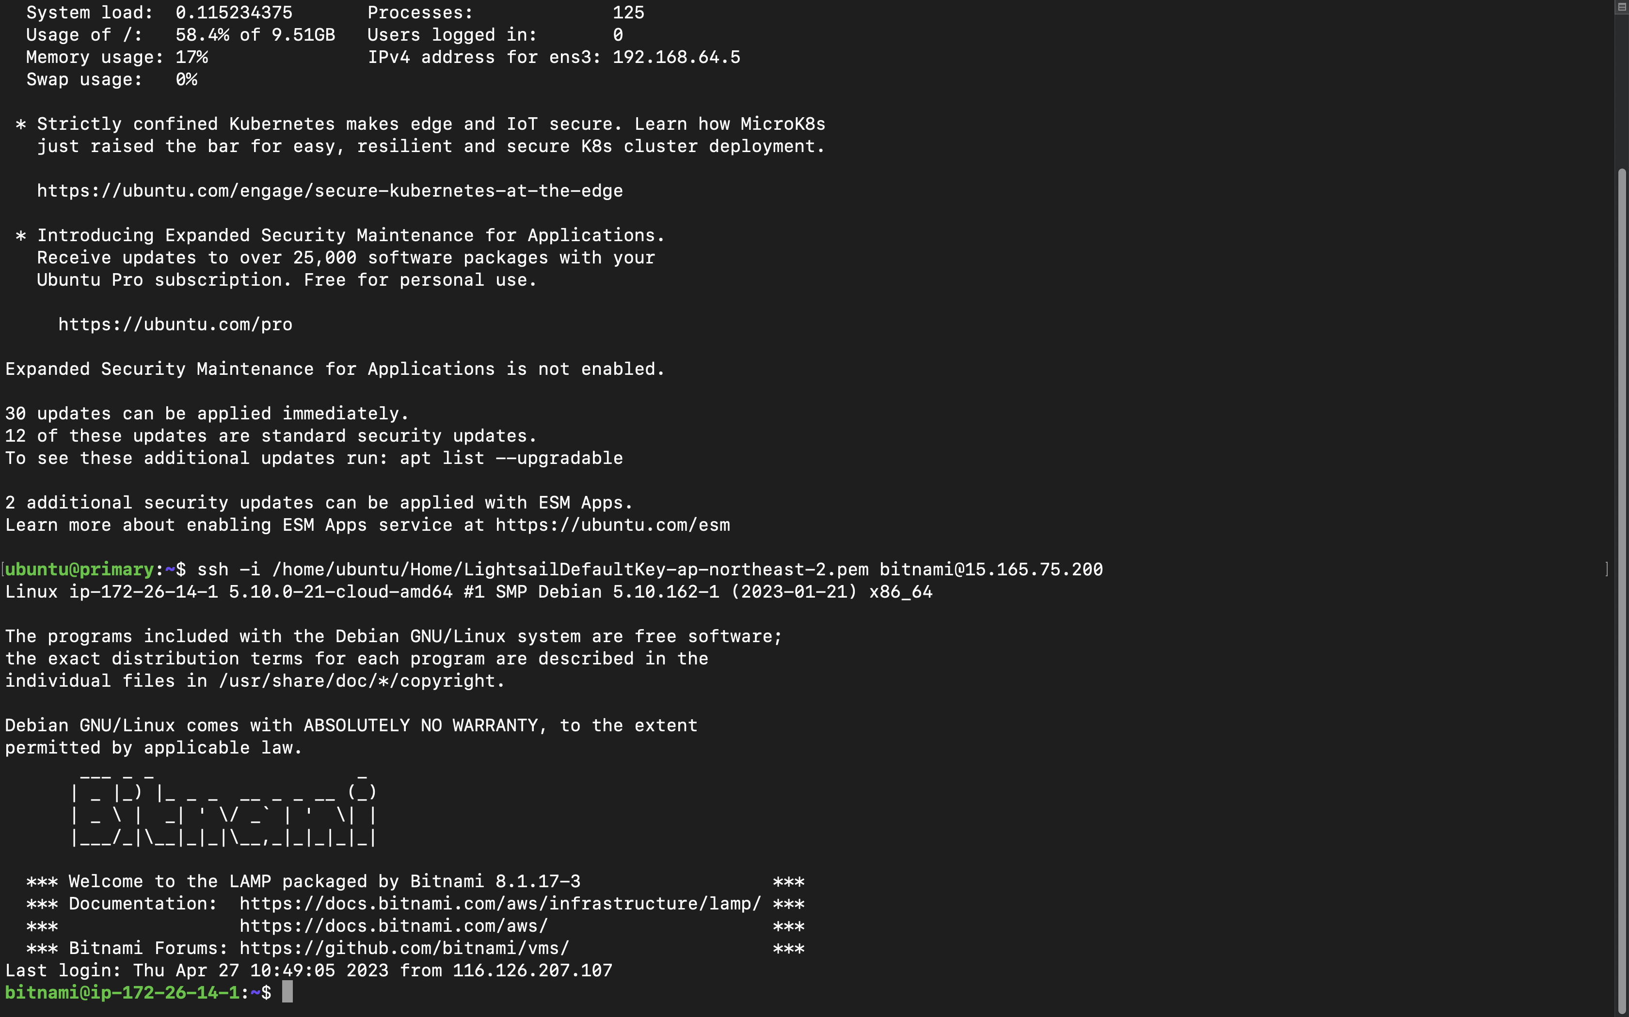


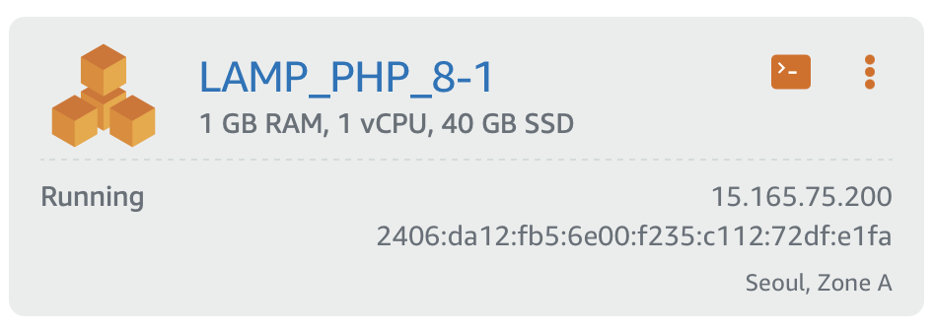
Part 3
Database
Notes:
We used amazon lightshail, provided by the amazon web service(aws), to create server instance. This instance includes MariaDB, which is basically same as MySQL, and phpMyAdmin and so on.

Slide 10
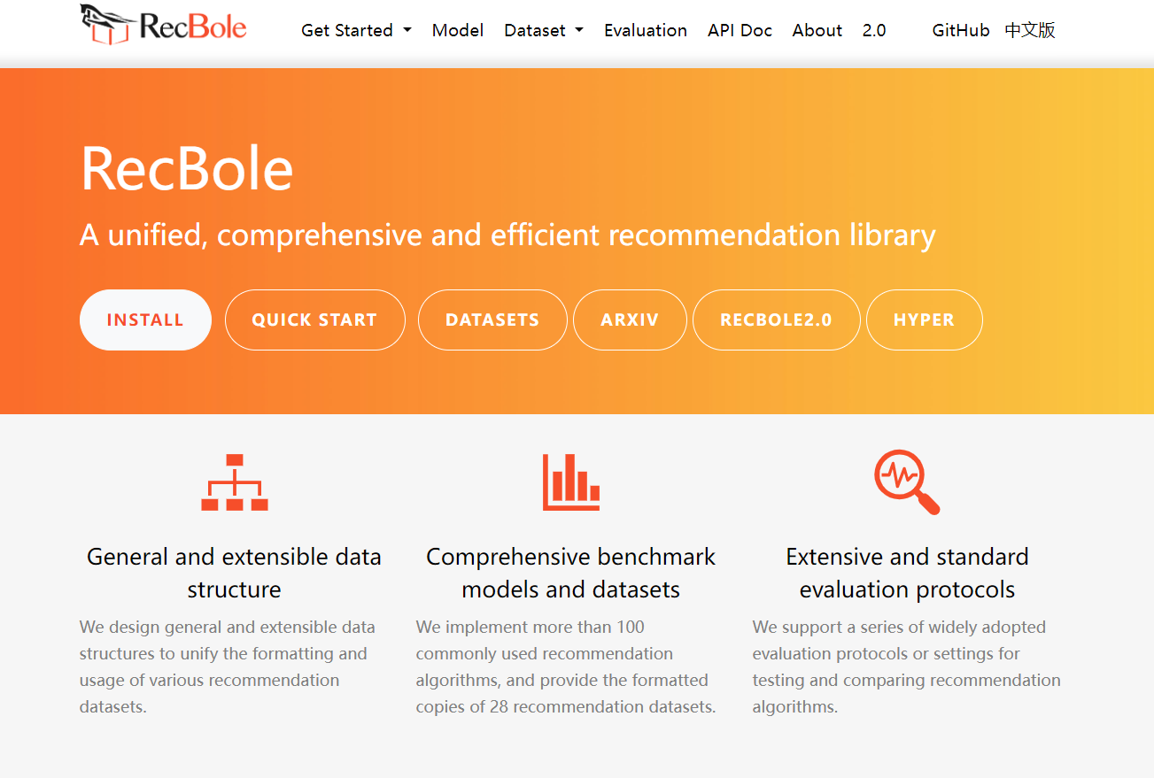
Part 2
Recbole
Notes:
We used a framework called recbole for model training and item recommendation prediction. The experiments and training were conducted outside of the server, and the trained models were uploaded to the server for prediction. Since training on the server can cause resource and time issues, we modified the framework code to enable only inferencing on the server using the trained model.

Slide 11



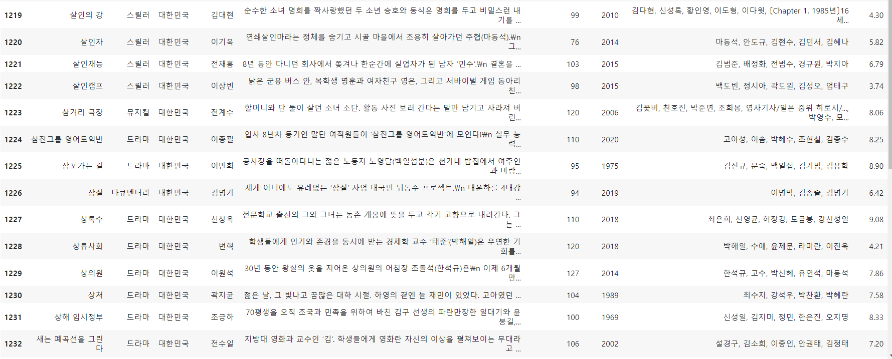

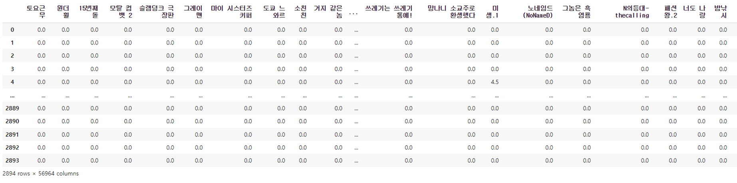

Part 1
Data Crawling
More than 22407 contents data collected only 10741 data was used.
5000 user preference data for training

Slide 12
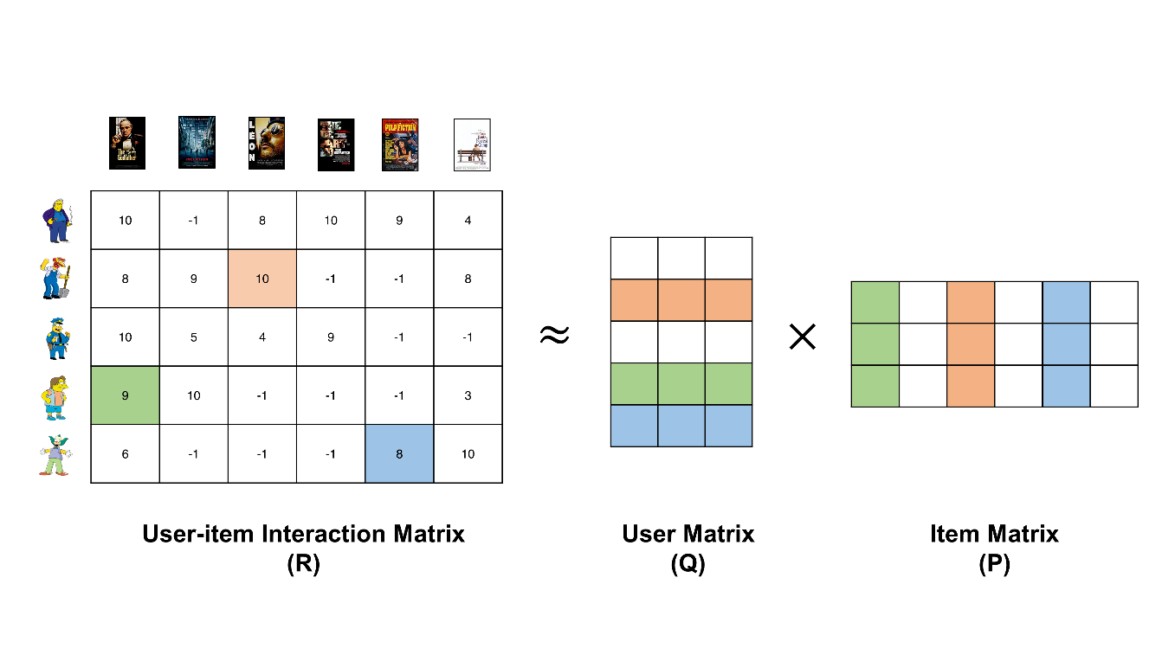
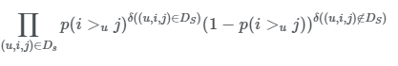
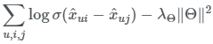
Part 2
BPR(MF)
Notes:
BPR focuses on pairwise comparisons of items. During training, it samples pairs of items and user interactions. For each pair, BPR learns to predict whether the user prefers one item over the other based on their interactions. The goal is to learn embeddings that rank preferred items higher than non-preferred items for each user.

Slide 13
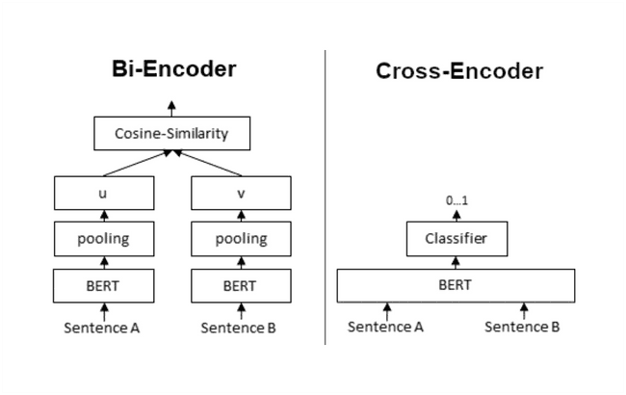
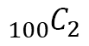
Part 2
Sentence Bert
Sentence-BERT: Sentence Embeddings using Siamese BERT-Networks(2019)
Mean pooling
BERT-base configuration
Max sequence Length: 256
100
= 4950
$${}_{100}^{ }{C_{2}}$$
Notes:
For content base

Slide 14
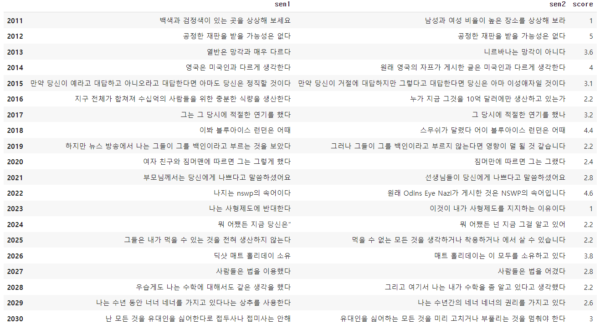
Part 2
Sentence Bert
KorSTS(Semantic Textual Similarity) by KakaoBrain
- KorNLI and KorSTS: New Benchmark Datasets for Korean Natural Language Understanding(2020)
Total : 8,628
Train : 5,749
Valid : 1,500
Test : 1,379
Batch size: 16
Epoch : 10 (early stopping)
Learning rate : 1e-5
MSE Loss
Adam Optimizer
Notes:
I will briefly explain the models because it is difficult to explain them in detail due to the time limit. BPR is a method using matrix decomposition of matrices. It's a model that applies fairwise loss to MF.

Slide 15
Part 4
Evaluations
ⓒSaebyeol Yu. Saebyeol’s PowerPoint

Slide 16
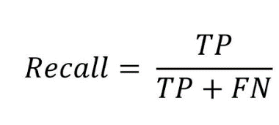
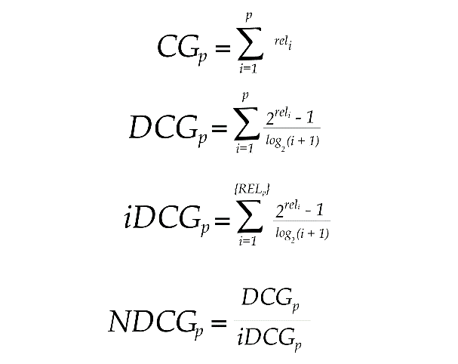
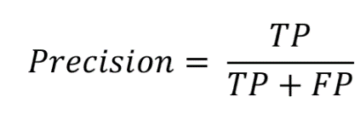
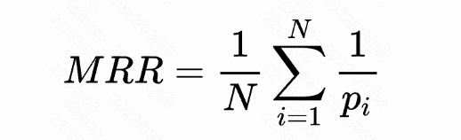
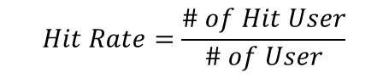
Part 4
Metrics
Recall
Precision
MRR
NDCG
Hit
Notes:
These are metrics used in the experiments. They are performance indicators commonly used in recommendations. Recall is the true positive divided by the sum of true positive and false negative. Precision is the true positive divided by the sum of true positive and false positive. MRR and NDCG are metrics specifically used in recommendations and were used to include the recommendation order in the performance evaluation. If five contents are recommended, even if all five are included in the contents the user has seen, a model that recommends preferred items first is better, so a weighting method is used based on the recommendation order. Hit represents the proportion of users who have at least one hit item among all users.

Slide 17
Part 4
Model evaluation
MODEL | Recall@10 | MRR@10 | NDCG@10 | Precision@10
Pop | 0.0379 | 0.2585 | 0.1008 | 0.0859
BPR | 0.0409 | 0.2745 | 0.1123 | 0.0976
ItemKnn | 0.059 | 0.3811 | 0.1655 | 0.1404
NeuMF | 0.0408 | 0.2598 | 0.1073 | 0.0951
MultVAE | 0.0524 | 0.3204 | 0.1379 | 0.1199
Notes:
Here's the performance of the models. In terms of performance metrics, ItemKnn showed the best performance. However, considering the inference time, ItemKnn took a significantly long time, which is not desirable for actual service deployment. Therefore, we selected BPR as the final model, which has a shorter inference time, taking into account the real-time service scenario.

Slide 18
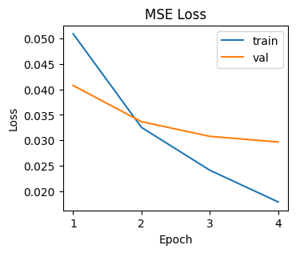
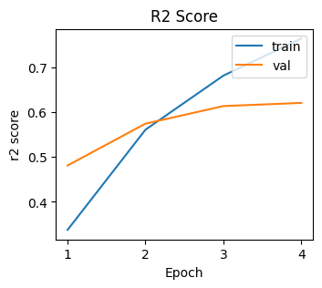
Part 4
Model evaluation : Sentence BERT
Test data:
MSE Score:0.036
R2_Score:0.558
Notes:
Here's the performance of the models. Although the parameter tuning has not been carried out properly, it can be seen that the itemKnn has the best performance so far.

Slide 19
Part 5
Functions
ⓒSaebyeol Yu. Saebyeol’s PowerPoint

Slide 20
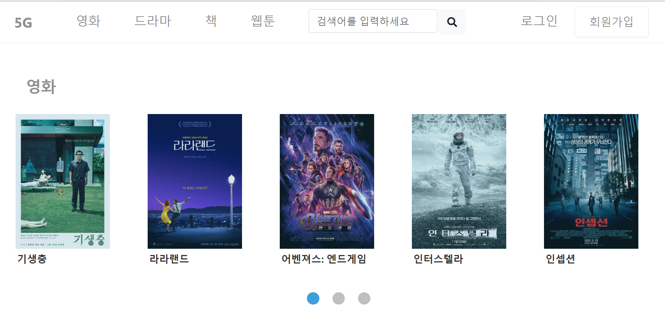
Part 4
Main page
Notes:
Here's the performance of the models. Although the parameter tuning has not been carried out properly, it can be seen that the itemKnn has the best performance so far.

Slide 21

Part 4
Registering
Notes:
Here's the performance of the models. Although the parameter tuning has not been carried out properly, it can be seen that the itemKnn has the best performance so far.

Slide 22
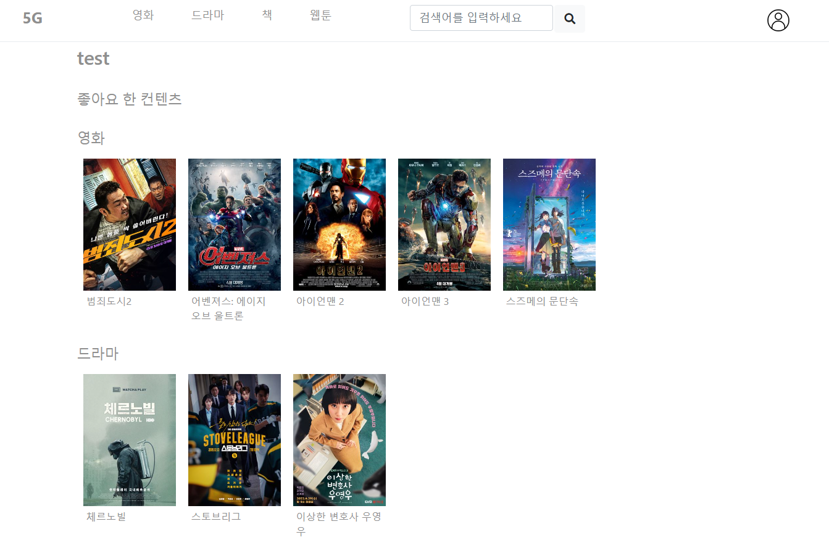
Part 4
My page
Notes:
Here's the performance of the models. Although the parameter tuning has not been carried out properly, it can be seen that the itemKnn has the best performance so far.

Slide 23

Part 4
Content Page
Cosine Similarity
Total Similarity = 0.2*Title Similarity + 0.1*Genre Similarity + 0.7*Description Similarity
Notes:
Here's the performance of the models. Although the parameter tuning has not been carried out properly, it can be seen that the itemKnn has the best performance so far.

Slide 24
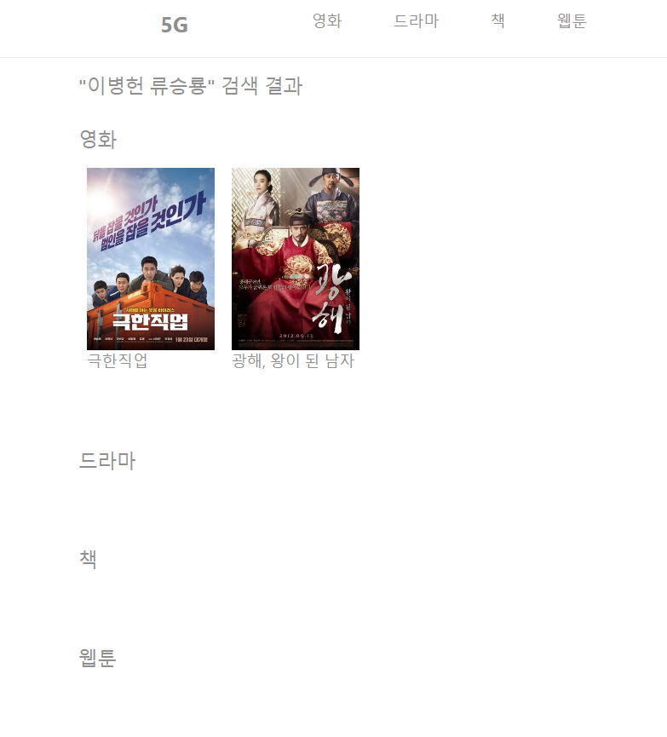
Part 4
Search page
Notes:
Here's the performance of the models. Although the parameter tuning has not been carried out properly, it can be seen that the itemKnn has the best performance so far.

Slide 25
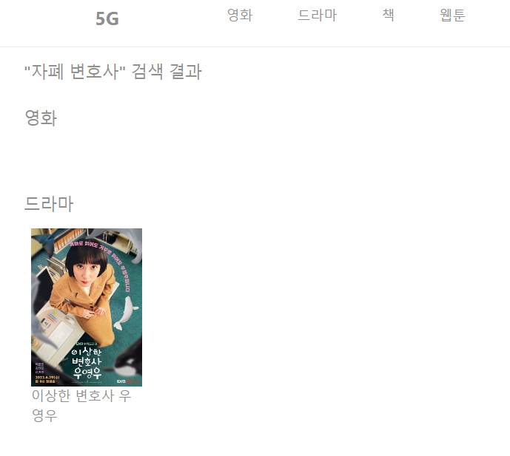
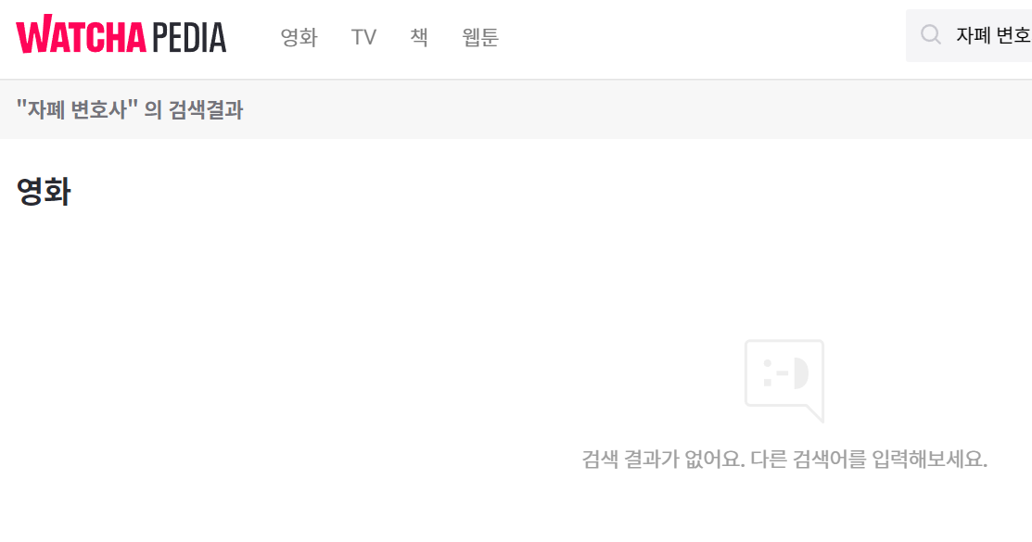
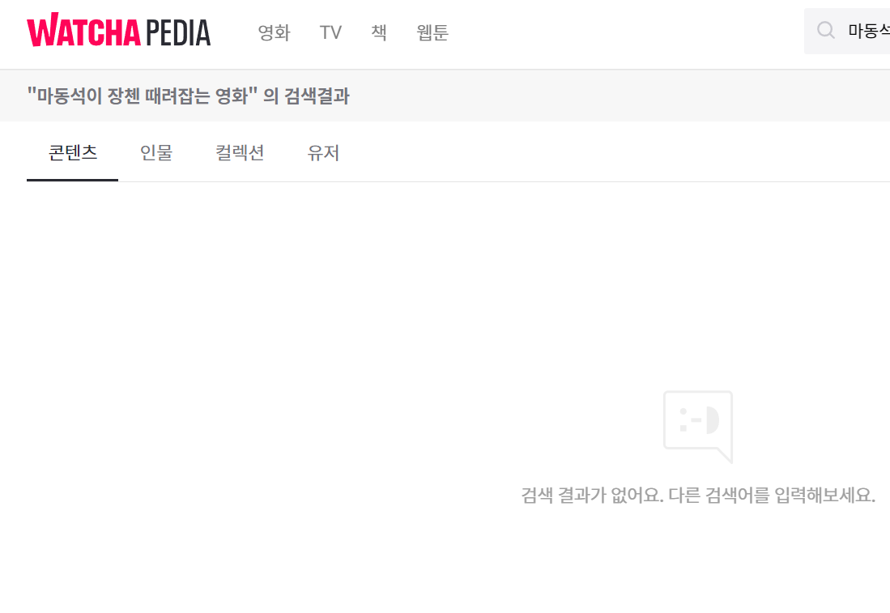
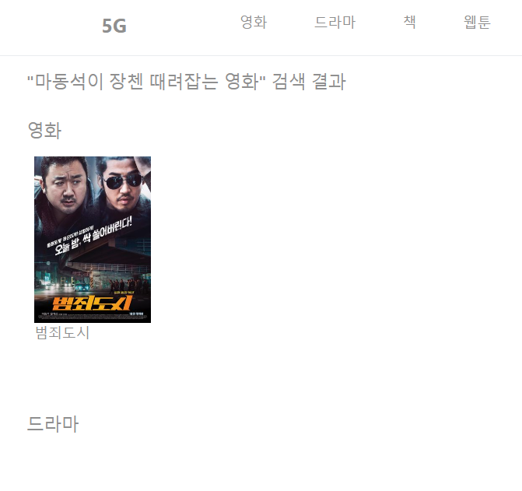
Part 5
Search page
Notes:
Here's the performance of the models. Although the parameter tuning has not been carried out properly, it can be seen that the itemKnn has the best performance so far.

Slide 26
Part 6
Challenges and Limitations
ⓒSaebyeol Yu. Saebyeol’s PowerPoint

Slide 27
Part 6,
Challenges
Data
Connection server with DB
no existing well-organized data
Crawling with selenium
Need cross-domain data
Differences between localhost and server
DB deployment
Schema Design
Model implement
Show image
Limitations of server computing resources
Model learning and service connections
compatibility between different languages
Large file capacity
Special characters in file name
Setting the path to a file

Slide 28
Part 6,
Limitation
001
>>
Too Slow service
002
>>
Simultaneous registration of multi-user
003
>>
Description only contains limited information

Slide 29
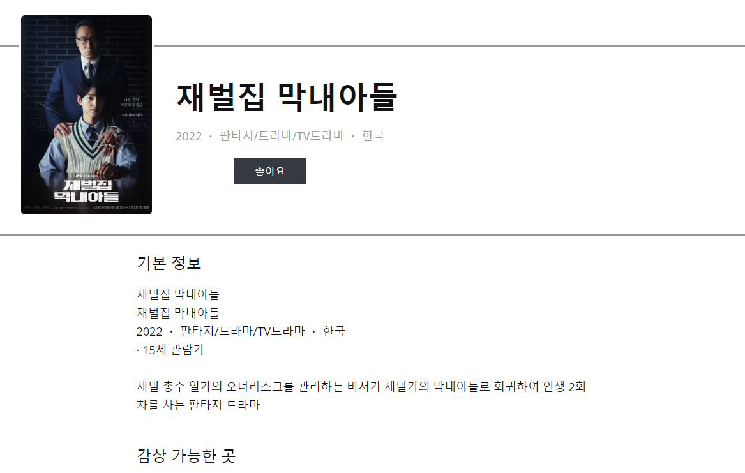
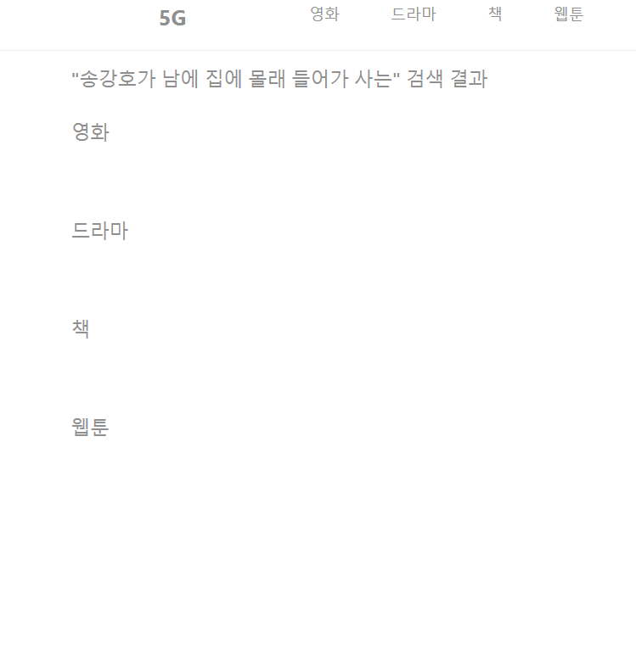

Part 6,
Limitation
The Description(Synopsis) contains limited information

Slide 30
Part 7
Final Implementation: Demo
ⓒSaebyeol Yu. Saebyeol’s PowerPoint

